Slide 1

WELCOME

Slide 2
FERTILIZER RECOMMENDATION SYSTEM FOR DISAESE PREDICTION
Domain : Artificial Intelligence
TEAM ID : PNT2022TMID38677
TEAM SIZE : 4
Team Leader : Vincy Rashitha EL
1.Team Member : Dhatchayani S
2.Team Member : Saraswathi K
3.Team Member : Divya K
INDUSTRY MENTOR SPOC FACULTY MENTOR PROJECT EVALUATOR
MS. DURGA PRASAD Dr.A.BHUVENSWARI M.E.Ph.D Dr.N.ELAMATHI M.E.,Ph.D., MR.M.EZHILVENDHAN M.Tech.,

Slide 3
PRESENTATION OVERVIEW
Abstract
Problem Statement
Proposed Solution
Technical Architecture
Demo of the project
Performance Metrics
Scalability
Future Scope

Slide 4
ABSTRACT
Agriculture is the most important sector in today’s life,Most plants are affected by a wide variety of bacterial and fungal diseases.
Diseases on plants placed a major constraint on the production and a major threat to food security.
Hence, early and accurate identification of plant diseases is essential to ensure high quantity and best quality.
In recent years, the number of diseases on plants and the degree of harm caused has increased due to the variation in pathogen varieties, changes in cultivation methods, and inadequate plant protection techniques.
An automated system is introduced to identify different diseases on plants by checking the symptoms shown on the leaves of the plant.
The most efficient technique is used to identify the diseases and suggest the precautions that can be taken for those diseases.

Slide 5
PROBLEM STATEMENT
To grow, plants require nitrogen compounds from the soil can be produced naturally or be provided by fertilizers.
However, applying excessive amounts of fertilizer leads to the release of harmful greenhouse gases into the atmosphere and the eutrophication of our waterways
Fertilizers are additional substances supplied to the crops to increase their productivity. These are used by the farmers daily to increase the crop yield.
These fertilizers contain essential nutrients required by the plants, including nitrogen, potassium, and phosphorus
Excess amounts of fertilizers may enter streams creating sources of nonpoint pollution. Fertilizers most commonly enter water sources by surface runoff and leaching from agricultural lands.
Large amounts of nitrogen and phosphorous are present in the runoff.

Slide 6
PROPOSED SOLUTION
The proposed solution should relate the current situation to a desired result which describe the beneﬁts that will be accruate when the desired result is achieved. So,begin your proposed solution by brieﬂy describing this desired result.
Improve Farming Productivity .
Implementation of land reforms
Smart water management.
Adopt genetically modified crops
Develop high-yield crops

Slide 7
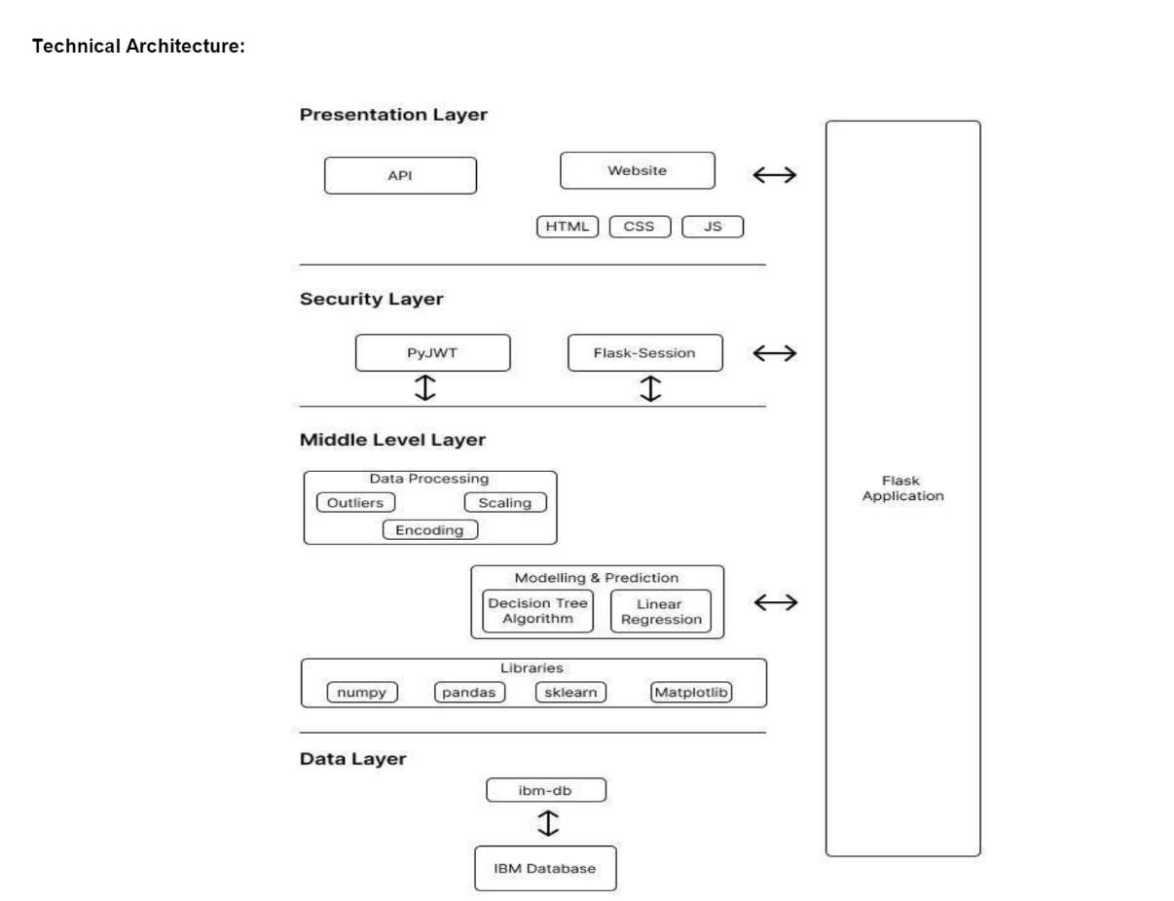
TECHNICAL ARCHITECTURE

Slide 8
DEMO OF THE PROJECT
.

Slide 9
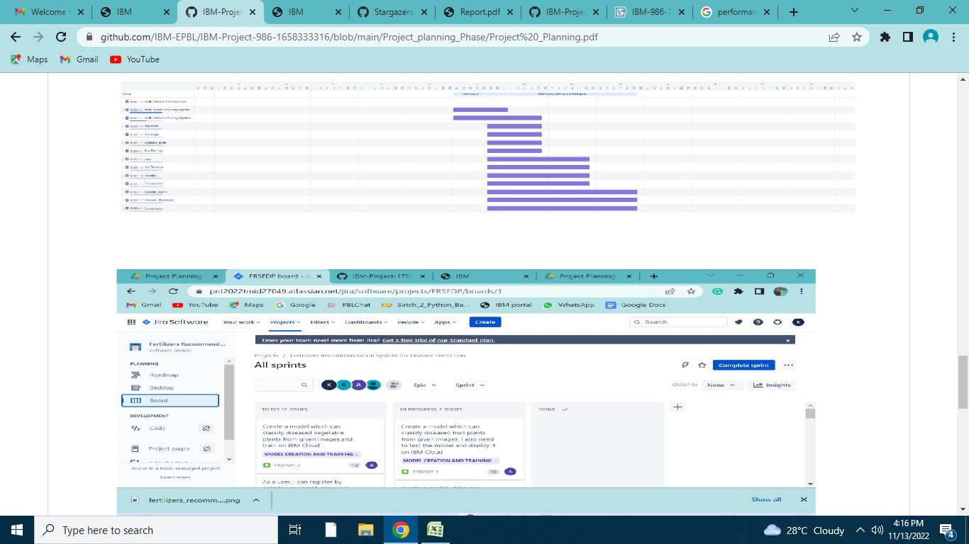
PERFORMANCE METRICS
Performance metrics are deﬁned as ﬁgure and data representative of an organization's actions, abilities, and overallquality.

Slide 10
SCALABILITY/FUTURE SCOPE
We can able to predict various kinds of plant disease in the plant.
The parameters as pH, temperature, humidity, and moisture are include for the plant disease prediction.
Mostly it saves the soil condition and help in the rich nutrient in the plant growth.

Slide 11
THANK YOU

